Slide 1
BACKLOG Update
AZSITE Consortium Board Meeting
10/28/2020

Slide 2
ARO Site Card Backlog vs. AZSITE Backlog vs. New Submissions
ARO site card backlog: old fee structure projects submitted before July 1, 2018
AZSITE backlog: small pool of older projects passed on to AZSITE prior to new fee structure.
Many of these were still in the ARO Site Card backlog; no longer going to talk about these separately.
Newer submittals have been prioritized in an organized workflow in the new fee structure

Slide 3
More Backlog Available for Upload
Site Card Backlog Original Site Submissions (new sites)
AZSITE checks boundaries in detail against report, or generates them
AZSITE checks attributes (to an extent), or generates them
Site Card Backlog Projects
AZSITE checks boundaries in detail against PRF/report, or generates them
AZSITE checks attributes (to an extent), or generates them
AZSITE uploads new sites associated with project
AZSITE uploads basic update for site updates associated with project
Links site to project and references
Site cards and site card updates will not be uploaded until curated by the ARO.
New sites with this status are indicated as such in the remarks.
Site updates with this status are indicated as such in the history remarks

Slide 4
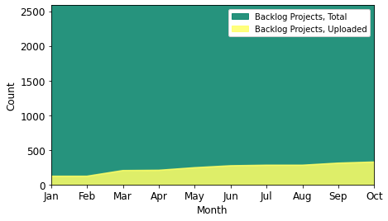
Backlog Progress
Projects
326 in AZSITE attributes (279 with geometries)
136 of these are negative surveys
2,260 projects not in AZSITE attributes (2,307 without geometries)
80% have project area shapefile of some sort
Of 47 projects with attributes and no geometry, 22 have shapefiles.
Goal: 25-50 projects uploaded per week

Slide 5
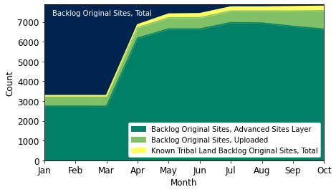
Backlog Progress
Original Site Submissions (new sites)
950 in AZSITE attributes (938 with geometries)
226 known to be on tribal land
6,716 not in AZSITE attributes (6,728 without geometries)
80% have site boundary shapefiles of some sort
Site cards will not be uploaded until ARO completes curation.
This is indicated in site remarks
Goal is to upload 100 new sites per week

Slide 6
Backlog Progress
Site Updates
161 basic site updates from backlog uploaded recently
Sites tied to project and reference(s)
Potential boundary update, site card update, detailed attribute update are pending ARO curation
This status is indicated in history remarks
373 total site updates from backlog are present in AZSITE
Consist of project-site link at minimum
6,753 basic updates remaining by this count
7,126 total in backlog that are not known to be on tribal land

Slide 7
Advanced Sites Layer
More than 4,200 backlog site centerpoints added this year
99% coverage of backlog original site submissions in advanced sites/sites

Slide 8
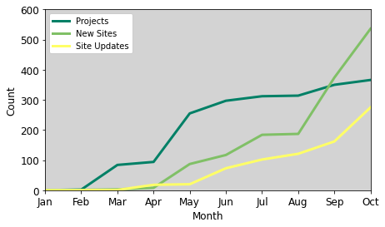
Total Uploads, 2020
366 projects (128 new fee structure)
536 new sites (11 new fee structure)
275 site updates
309 PRFs
280 site cards/site card updates

Slide 9
THANK YOU

